Slide 1
Field trip to
telok ayer street
GES1038 Tutorials 3 & 4

Slide 2

Sites to visit
in sequence:
1. Thian Hock Keng
2. Ying Fo Fui Kun
3. Fuk Tak Chi
4. Yueh Hai Ching Temple

Slide 3
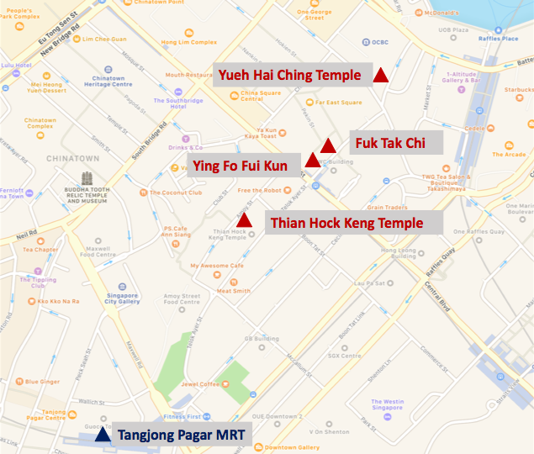
Direction
4
3
2
Telok Ayer MRT
1

Slide 4
If you are taking MRT to Telok Ayer Street, you may choose to alight at Telok Ayer MRT station (DT18) or Tanjong Pagar MRT station (EW15), though the virtual fieldtrip video only shows the former.
Please refrain from taking photographs of deities when you are in the temples.
Remember to bring drinking water and umbrella with you.

Slide 5
We will upload the virtual fieldtrip videos only after the completion of tutorial 1 (i.e. on 5th Feb 2021).
Though we encourage you to visit Telok Ayer Street by yourself, please note that this is not compulsory.
If you are visiting Telok Ayer Street by yourself, please ensure that you do not violate rules meant to curb the spread of COVID-19 in Singapore. Please keep yourself updated of any new rules as the COVID-19 situation in Singapore is evolving.

Slide 6

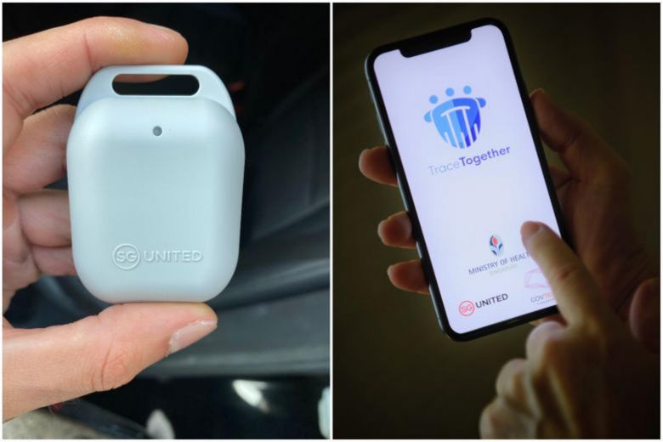




Enjoy your trip!

